Slide 1
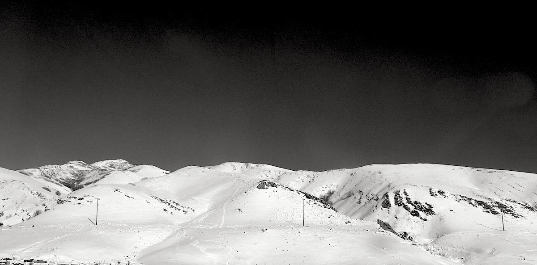
Finding patterns in genomes
Applied Computational Genomics
https://github.com/quinlan-lab/applied-computational-genomics
Aaron Quinlan
Departments of Human Genetics and Biomedical Informatics
USTAR Center for Genetic Discovery
University of Utah
quinlanlab.org

Slide 2
But first a bit more Unix to whet our appetite.

Slide 3
When you type ls Unix just "knows" what to do. Or does it?
$ ls

Slide 4

Actually, the ls command (and nearly all standard Unix commands) live in specific directories:
/
"root"
home
bin
usr
ls
head
grep
...
bin
ls
head
grep
...
Typically either /usr/bin or /bin

Slide 5
Let's check with the which command
$ man which
$ which ls
/usr/bin/ls
$ which cat
/usr/bin/cat
$ which head
/usr/bin/head
$ which grep
/usr/bin/grep

Slide 6
The PATH environment variable
$ echo $PATH
/usr/local/bin:/usr/bin:/usr/local/bowtie2:/usr/local/sbin:/usr/sbin:/home/u1007787/.local/bin:/home/u1007787/bin
The PATH environment variable is a colon-delimited list of directories that your shell will automagically search through to find the executables when you enter a command. Executables may be kept in many different places on the Unix system. You gotta throw UNIX a bone so it doesn't file for worker's comp.
The echo command is the same as cat, but whereas cat is for files, echo is for "environment variables"
https://kb.iu.edu/d/acar

Slide 7
Unix searches your PATH automagically
$ echo $PATH
/usr/local/bin:/usr/bin:/usr/local/bowtie2:/usr/local/sbin:/usr/sbin:/home/u1007787/.local/bin:/home/u1007787/bin
$ cowsay "Make Amoorica Great Again"
https://kb.iu.edu/d/acar

Slide 8
Unix searches your PATH automagically
$ echo $PATH
/usr/local/bin:/usr/bin:/usr/local/bowtie2:/usr/local/sbin:/usr/sbin:/home/u1007787/.local/bin:/home/u1007787/bin
$ cowsay "Make Amoorica Great Again"
No dice. Keep looking.
https://kb.iu.edu/d/acar

Slide 9
Unix searches your PATH automagically
$ echo $PATH
/usr/local/bin:/usr/bin:/usr/local/bowtie2:/usr/local/sbin:/usr/sbin:/home/u1007787/.local/bin:/home/u1007787/bin
$ cowsay "Make Amoorica Great Again"
No dice. Keep looking.
https://kb.iu.edu/d/acar

Slide 10
Unix searches your PATH automagically
$ echo $PATH
/usr/local/bin:/usr/bin:/usr/local/bowtie2:/usr/local/sbin:/usr/sbin:/home/u1007787/.local/bin:/home/u1007787/bin
$ cowsay "Make Amoorica Great Again"
No dice. Keep looking.
https://kb.iu.edu/d/acar

Slide 11
Unix searches your PATH automagically
$ echo $PATH
/usr/local/bin:/usr/bin:/usr/local/bowtie2:/usr/local/sbin:/usr/sbin:/home/u1007787/.local/bin:/home/u1007787/bin
$ cowsay "Make Amoorica Great Again"
bash: cowsay: command not found...
https://kb.iu.edu/d/acar

Slide 12
So what is wrong?
The problem is that cowsay is a custom piece of software (much like any specialized bioinformatics software we will use in the future) that one must install on one's system. It is not installed on Unix by default.

Slide 13
So let's fix that by installing it ourselves!
$ cd ~
$ mkdir bin
$ cd bin
$ curl https://gist.githubusercontent.com/arq5x/484539baae07797f162a3c8eca601117/raw/700615864064177ebbd54dcf25594e6034c468bc/cowsay > cowsay
$ chmod a+x cowsay
$ cd ..
Copy / paste ALL of this at once
Make cowsay executable for all

Slide 14
/home/uNID/bin is already in our PATH
$ echo $PATH
/usr/local/bin:/usr/bin:/usr/local/bowtie2:/usr/local/sbin:/usr/sbin:/home/u1007787/.local/bin:/home/u1007787/bin
https://kb.iu.edu/d/acar

Slide 15
Now you can run cowsay
$ cowsay "Make Amoorica Great Again"
___________________________
< Make Amoorica Great Again >
---------------------------
\ ^__^
\ (oo)\_______
(__)\ )\/\
||----w |
|| ||

Slide 16
Adding _new_ directories to PATH
The colon says append the directory following it to the variable ($PATH) preceding it.
$ PATH=$PATH:/home/u1007787/tools
$ echo $PATH
/usr/local/bin:/usr/bin:/usr/local/bowtie2:/usr/local/sbin:/usr/sbin:/home/u1007787/.local/bin:/home/u1007787/bin:/home/u1007787/tools

Slide 17
Again - be lazy! Create your own environment variables.
MYFILE=/home/u1007787/proj1/2017-Jan-28/version1/debugging/whatisthewhat/data.2.clean.final.txt
$ grep ACTTC $MYFILE
https://kb.iu.edu/d/acar

Slide 18
Thought experiment: you are designing primers to PCR-amplify a particular exon you are interested in. You are concerned about off target effects.
How can you find other loci that might be amplified?

Slide 19
Searching for and counting patterns in genomes with grep
Let's create a file called patterns/hg.b38.chr22.fa in your home directory.
cd ~
mkdir patterns
cd patterns
curl http://hgdownload.cse.ucsc.edu/goldenPath/hg38/chromosomes/chr22.fa.gz > chr22.fa.gz
gzip -d chr22.fa.gz
mv chr22.fa hg.b38.chr22.fa

Slide 20
Don't run this command!
Think. What will this command do?
$ grep > hg.b38.chr22.fa

Slide 21
Avoid overwriting FASTA files.
Wrap your search pattern in quotes
$ grep ">" hg.b38.chr22.fa

Slide 22
How could we determine how many nucleotides are in chr22?
$ grep -v ">" hg.b38.chr22.fa | wc -c
51834838
Wait - this is wrong, as newlines are being counted (they are characters too). How do we fix this?

Slide 23
How could we determine how many nucleotides are in chr22?
$ grep -v ">" hg.b38.chr22.fa | wc -l
1016370
$ grep -v ">" hg.b38.chr22.fa | wc -c
51834838
51834838 - 1016370 = 50818468

Slide 24
How many adenosines are there on chr22?
$ grep -v ">" hg.b38.chr22.fa | grep -c "A"
410249

Slide 25
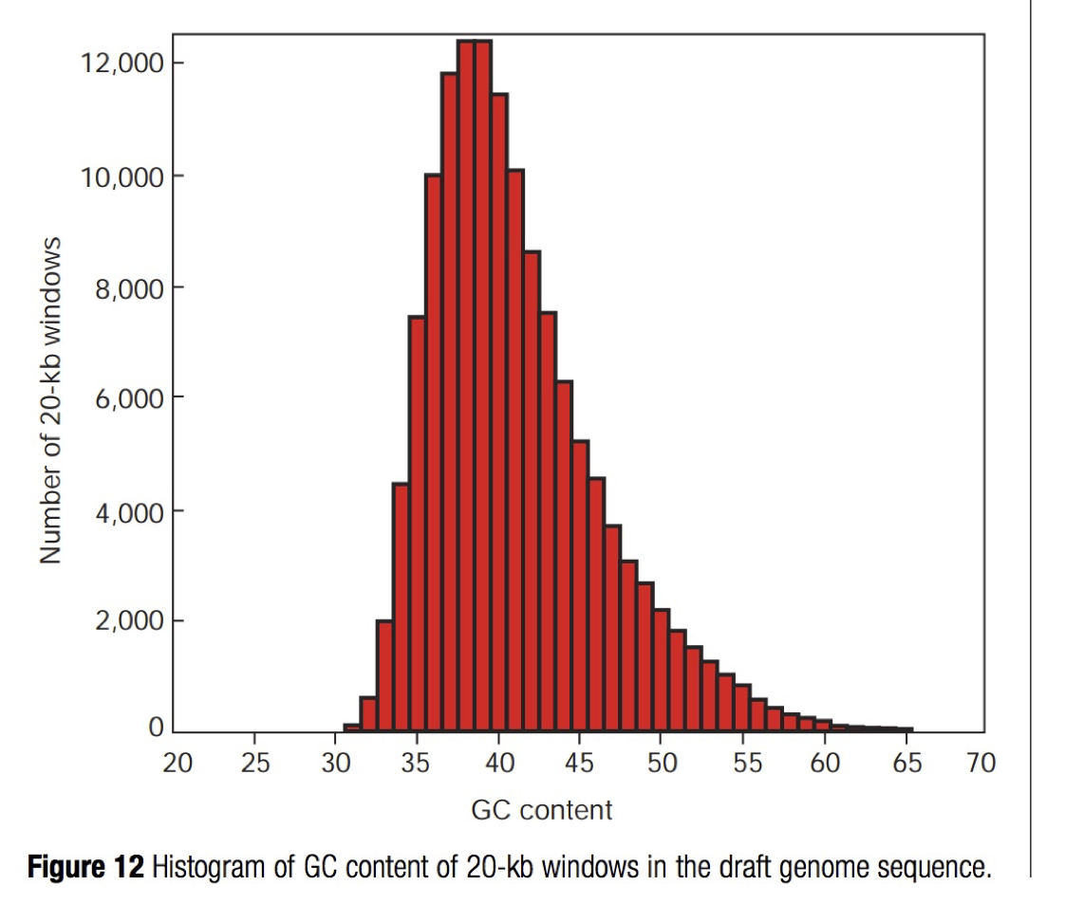
Let's sanity check our work.
We learned in the last lecture that ~42% of the human genome is GC.
Therefore the AT content is ~58%
Thus we expect the A content to be ~58% / 2
But we see 410249 / 50818468 = 0.8%
Fishy! What is going on here?

Slide 26
Man page entry for grep -c
-c, --count
Suppress normal output; instead print a count of matching lines for each input file.

Slide 27
The -o option
-o, --only-matching
Print only the matched (non-empty) parts of a matching line, with each such part on a separate output line.

Slide 28
The -n option
-n, --line-number
Prefix each line of output with the 1-based line number within its input file.

Slide 29
How many adenosines are there on chr22?
$ grep -v ">" hg.b38.chr22.fa | grep -o -n "A" | head -n 16
210201:A
210201:A
210201:A
210201:A
210201:A
210201:A
210201:A
210201:A
210201:A
210201:A
210201:A
210201:A
210201:A
210201:A
210201:A
210202:A
Line number:match

Slide 30
Sanity check: let's look at line 210201 and the next 10 after it. How?
grep -v ">" hg.b37.chr22.fa | head -n 210210 | tail -n 10
GAATTCTTGTGTTTATATAATAAGATGTCCTATAATTTCTGTTTGGAATA
TAAAATCAGCAACTAATATGTATTTTCAAAGCATTATAAATACAGAGTGC
TAAGTTACTTCACTGTGAAATGTAGTCATATAAAGAACATAATAATTATA
CTGGATTATTTTTAAATGGGCTGTCTAACATTATATTAAAAGGTTTCATC
AGTAATTCATTATATCAAAATGCTCCAggccaggcgtggtggcttatgcc
tgtaatcccagcactttgggaggtcgaagtgggcggatcacttgaggtca
ggagttggagactagcctggccaacatgatgaaaccccgtctctaataat
aataataaaaaaaaattagctgggtgtggtggtgggcaactgtaatctca
gctaatcaggaggctgaggcagaagaattgcttgaacgtggaagacagag
tttacagtgtgccaagatcacaccaccctactccaacttgggtgacagag

Slide 31
Sanity check: let's look at line 210201 and the next 10 after it. Or, less error prone
grep -v ">" hg.b38.chr22.fa | cat -n | grep -A 10 210201
210201 GAATTCTTGTGTTTATATAATAAGATGTCCTATAATTTCTGTTTGGAATA
210202 TAAAATCAGCAACTAATATGTATTTTCAAAGCATTATAAATACAGAGTGC
210203 TAAGTTACTTCACTGTGAAATGTAGTCATATAAAGAACATAATAATTATA
210204 CTGGATTATTTTTAAATGGGCTGTCTAACATTATATTAAAAGGTTTCATC
210205 AGTAATTCATTATATCAAAATGCTCCAggccaggcgtggtggcttatgcc
210206 tgtaatcccagcactttgggaggtcgaagtgggcggatcacttgaggtca
210207 ggagttggagactagcctggccaacatgatgaaaccccgtctctaataat
210208 aataataaaaaaaaattagctgggtgtggtggtgggcaactgtaatctca
210209 gctaatcaggaggctgaggcagaagaattgcttgaacgtggaagacagag
210210 tttacagtgtgccaagatcacaccaccctactccaacttgggtgacagag
210211 caagactcagtctcaaggaaaaaaaaaaGCTCGAAAAATGTTTGCTTATT
Add line number.
Report the 10 lines "After the match
We have a major flaw in our experiment. What is it?

Slide 32
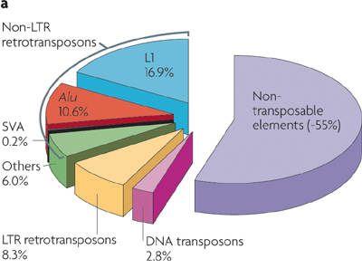

Repeat Masking
grep -v ">" hg.b37.chr22.fa | cat -n | grep -A 10 210201
210201 GAATTCTTGTGTTTATATAATAAGATGTCCTATAATTTCTGTTTGGAATA
210202 TAAAATCAGCAACTAATATGTATTTTCAAAGCATTATAAATACAGAGTGC
210203 TAAGTTACTTCACTGTGAAATGTAGTCATATAAAGAACATAATAATTATA
210204 CTGGATTATTTTTAAATGGGCTGTCTAACATTATATTAAAAGGTTTCATC
210205 AGTAATTCATTATATCAAAATGCTCCAggccaggcgtggtggcttatgcc
210206 tgtaatcccagcactttgggaggtcgaagtgggcggatcacttgaggtca
210207 ggagttggagactagcctggccaacatgatgaaaccccgtctctaataat
210208 aataataaaaaaaaattagctgggtgtggtggtgggcaactgtaatctca
210209 gctaatcaggaggctgaggcagaagaattgcttgaacgtggaagacagag
210210 tttacagtgtgccaagatcacaccaccctactccaacttgggtgacagag
210211 caagactcagtctcaaggaaaaaaaaaaGCTCGAAAAATGTTTGCTTATT
McClintock's "jumping
genes" in maize
http://www.nature.com/nrg/journal/v10/n10/pdf/nrg2640.pdf

Slide 33
We need to search for "A" or "a"
The name "grep" stands for "global regular expression print".
$ grep -v ">" hg.b38.chr22.fa | grep -o -n "[A|a]" | less
Our first regular expression.
Match "A" or (|) "a"

Slide 34
LEFT OFF HERE!

Slide 35
Other example regular expressions.
# match AATTCCAA or AATTCGAA
$ grep -v ">" hg.b38.chr22.fa | grep "AATTC[CG]AA" | less

Slide 36
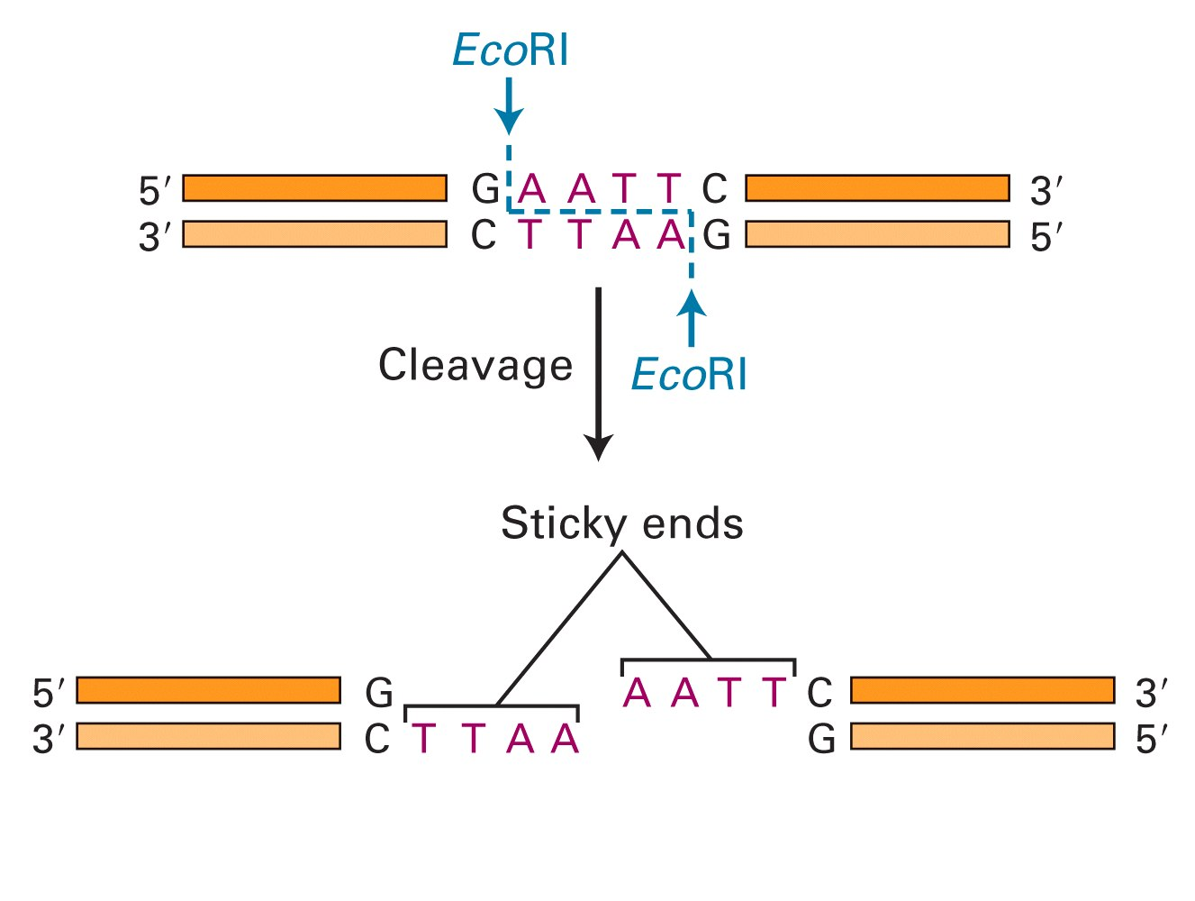
Restriction enzymes are pattern matchers!

Slide 37
Find EcoR1 cut sites
# match GAATTC
$ grep -v ">" hg.b38.chr22.fa | grep "GAATTC" | less

Slide 38
Match on a specific pattern, followed by "anything"
# match gene_id followed by any non-whitespace surrounded by quotes.
# This uses Perl regular expression syntax.
$ grep -o -P "gene_id \"\S+\"" genes.gtf

Slide 39
How many adenosines are there on chr22?
$ grep -v ">" hg.b37.chr22.fa | grep -o -n "[A|a]" | wc -l
10382214

Slide 40
Let's sanity check our work.
We learned in the last lecture that ~42% of the human genome is GC.
Therefore the AT content is ~58%
Thus we expect the A content to be ~58% / 2
But we see 10382214 / 50818468 = 20.4%
Better, but still not what we expect. Why?
Need to remove gaps (Ns)! How?

Slide 41
So, how do we count the matches per line?
$ grep -v ">" hg.b37.chr22.fa | grep -o -n "[A|a]" | head -n 17
210201:A
210201:A
210201:A
210201:A
210201:A
210201:A
210201:A
210201:A
210201:A
210201:A
210201:A
210201:A
210201:A
210201:A
210201:A
210202:A
210202:A

Slide 42
The uniq command will convert sorted data into unique (distinct) occurrences.
210201:A
210201:A
210201:A
210201:A
210201:A
210201:A
210201:A
210201:A
210201:A
210201:A
210201:A
210201:A
210201:A
210201:A
210201:A
210201:A
210202:A
210202:A
210202:A

Slide 43
The uniq command will convert sorted data into unique (distinct) occurrences.
$ grep -v ">" hg.b37.chr22.fa | grep -o -n "[A|a]" | uniq | head
210201:A
210202:A
210203:A
210204:A
210205:A
210205:a
210206:a
210207:a
210208:a
210209:a

Slide 44
It will also -count the number of occurrences of each unique item it "sees".
How could we fix this?
$ grep -v ">" hg.b38.chr22.fa | grep -o -n "[A|a]" | uniq -c | head
15 210201:A
22 210202:A
22 210203:A
15 210204:A
11 210205:A
2 210205:a
11 210206:a
15 210207:a
19 210208:a
17 210209:a

Slide 45
Learning the sort | uniq dynamic duo
$ curl https://home.chpc.utah.edu/~u1007787/dna.txt > dna.txt
$ cat dna.txt
A
T
C
T
A
G
C
A
G
C
T
A
C
T
G

Slide 46
BUT - the data must be sorted for uniq to work properly.
$ cat dna.txt | uniq -c
1 A
1 T
1 C
1 T
1 A
1 G
1 C
1 A
1 G
1 C
1 T
1 A
1 C
1 T
1 G

Slide 47
Always sort | uniq unless you are certain the data are already sorted.
$ cat dna.txt | sort | uniq -c
4 A
4 C
3 G
4 T

Slide 48
Check out the -n and -r options for sort!

